Slide 1
Digital Portfolio
STUDENT NAME: Y.deeyathini
REGISTER NO AND NMID: 212400679
DEPARTMENT: BCA
COLLEGE: JAYA COLLEGE OF ARTS AND SCIENCE/ MADRAS UNIVERSITY

Slide 2
Interactive digital portfolio

Slide 3


AGENDA
Problem Statement
Project Overview
End Users
Tools and Technologies
Portfolio design and Layout
Features and Functionality
Results and Screenshots
Conclusion
Github Link
3/21/2024 Annual Review

Slide 4

PROBLEM STATEMENT
In today’s digital era, individuals need an effective way to showcase their skills, achievements, and experiences beyond traditional paper resumes and certificates. Traditional resumes are limited in scope, static in nature, and do not provide space for multimedia elements such as images, videos, project demos, and interactive content. This limitation reduces the ability of an individual to fully demonstrate their capabilities and creativity.
Therefore, there is a need for a digital portfolio system that allows individuals to create, manage, and showcase their personal and professional information in a modern, interactive, and user-friendly way.

Slide 5

PROJECT OVERVIEW
The Digital Portfolio Project provides a modern platform for individuals to showcase their skills, achievements, and projects online. It replaces traditional resumes with an interactive, multimedia-based profile that is accessible anytime, anywhere. The system is user-friendly, visually appealing, and helps improve personal branding and career opportunities.

Slide 6

WHO ARE THE END USERS?
The end users of a digital portfolio are mainly:
Students – to showcase academic achievements, projects, and skills.
Job Seekers/Professionals – to highlight experience, certifications, and career achievements.
Freelancers/Creators – to present creative works, designs, or services to potential clients.
Educators/Researchers – to display publications, teaching work, and research contributions.
Employers/Recruiters – as viewers who assess candidates’ skills and suitability.

Slide 7

TOOLS AND TECHNIQUES
Tools
Web Development Tools – HTML, CSS, JavaScript for creating and styling the portfolio.
Content Management Systems (CMS) – WordPress, Wix, or Google Sites for easy portfolio creation.
Design Tools – Canva, Figma, Adobe XD, Photoshop for graphics and layout.
Code Editors – Visual Studio Code, Sublime Text for coding and customization.
Hosting Platforms – GitHub Pages, Netlify, or personal domain hosting to publish the portfolio.
Techniques
Responsive Web Design – ensuring the portfolio works on all devices (desktop, tablet, mobile).
UI/UX Design Principles – making the portfolio attractive and user-friendly.
Multimedia Integration – adding images, videos, project demos, and links.
Interactive Elements – using animations, hover effects, or navigation menus for better engagement.
Search Engine Optimization (SEO) – improving visibility so that the portfolio can be easily found online.

Slide 8
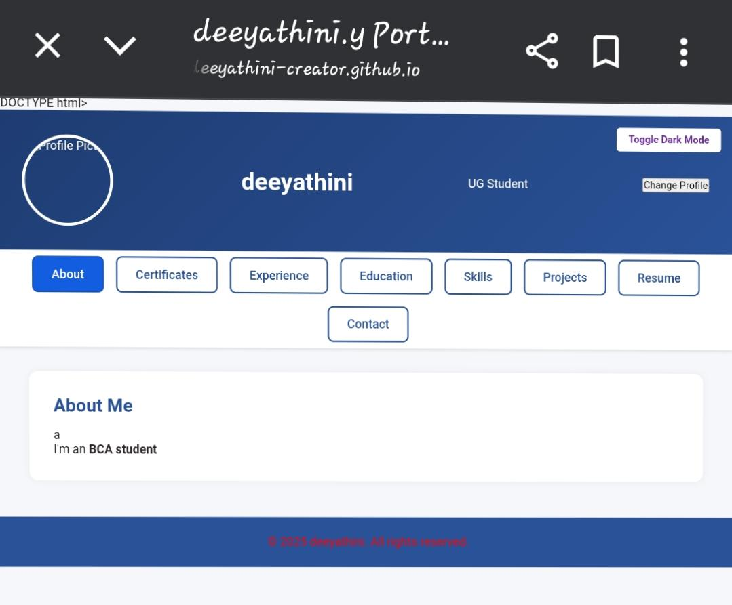
POTFOLIO DESIGN AND LAYOUT
1. Cover Page – Name, title, photo/logo
2. About Me – Short intro + skills
3. Projects/Work – Images + brief descriptions
4. Experience/Education – Timeline or list
5. Contact Page – Email, phone, social links
8

Slide 9
FEATURES AND FUNCTIONALITY
Features
Personalized Profile – includes name, photo, introduction, and career objective.
Project Showcase – ability to upload and display projects with descriptions, images, or links.
Skills Display – lists or graphical bars showing technical and soft skills.
Education & Experience Section – academic details, certifications, and work history.
Multimedia Support – images, videos, presentations, or demos.
Responsive Design – accessible on mobile, tablet, and desktop.
Search & Navigation – simple menus for easy access to different sections.
Functionality
Add / Edit / Update Content – users can manage their information anytime.
Interactive Elements – clickable links, animations, and hover effects.
Contact Integration – email, social media links, or a contact form.
Downloadable Resume – option to attach or download CV.
Sharing Options – portfolio link shareable on LinkedIn, job portals, etc.
SEO Optimization – improves visibility in search engines.
Data Security – safe handling of personal details.

Slide 10

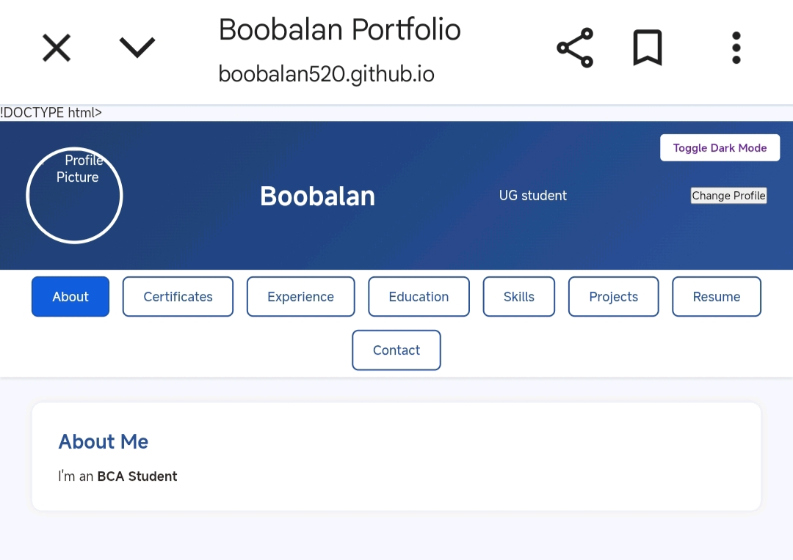
RESULTS AND SCREENSHOTS
Result: “The digital portfolio was successfully designed and implemented. It allows users to showcase their skills, projects, and achievements in an organized and visually appealing way. The portfolio is fully responsive, easy to update, and accessible across devices.”
3/21/2024 Annual Review
10

Slide 11
CONCLUSION
Conclusion
The Digital Portfolio serves as a modern and interactive platform for individuals to showcase their personal, academic, and professional achievements. Unlike traditional resumes, it provides a dynamic space to highlight skills, projects, and experiences using multimedia elements. It enhances personal branding, improves accessibility, and creates better opportunities for career growth. Overall, the digital portfolio is an effective tool that bridges the gap between an individual’s potential and the opportunities available in the digital world.
11

